Slide 1
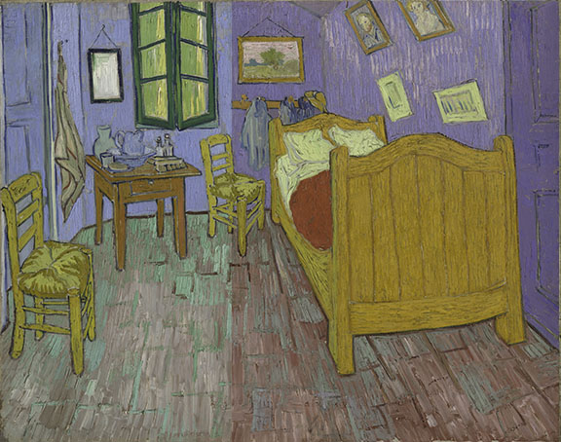

Computational X-Ray Fluorescence (XRF) Imaging using Dictionary Learning
Qiqin Dai¹, Emeline Pouyet², Oliver Cossairt¹,
Marc Walton², Aggelos Katsaggelos¹,
Francesca Casasdio²
¹Northwestern University, ²NU-ACCESS
Notes:
Good Morning/Hello. I am Ollie Cossairt, director of the NU comp imaging lab where we work on a variety of projects related to imaging, photography, image processing, computer vision and graphics. Today I will talk about Imaging Technologies for Surface Shape Study of the Art of Paul Gauguin. This is work that was done as part of a large collaboration between the NU Comp Photo Lab, the AIC, NU-ACCESS, the Georgia O-Keefe Museum, Scripps College, and ANE Imaging.

Slide 2
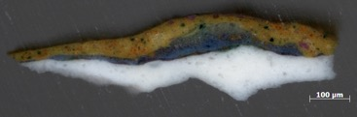
Why Imaging of Art?
Different modalities to interrogate structure
Ultraviolet (280-400 nm)
Visible (450-750 nm)
Infrared (750-2000nm)
X-ray (sub 10 nm)
Notes:
The size of a pigment particle varies considerably from less than 10 micrometers, which is comparable to milled flour to over 100 micrometers, which corresponds to fine sand.

Slide 3
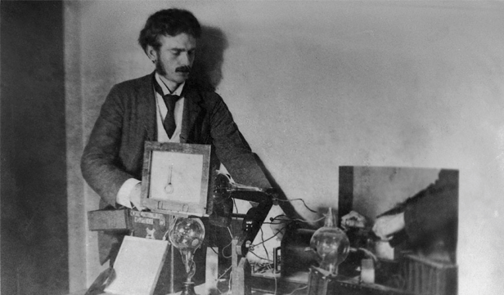
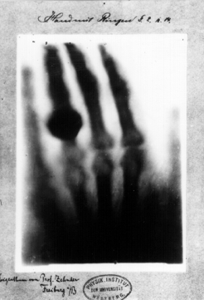
X-Ray Radiography & X-Ray Fluorescence Imaging
Röntgen, X-Ray Shadowgraph, 1890’s
Notes:
Ana Bertha Ludwigs hand

Slide 4
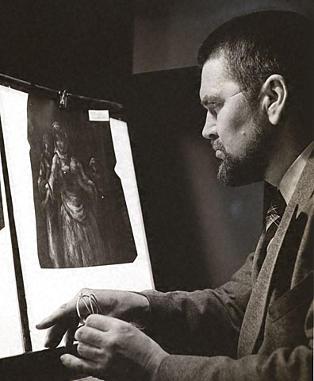
Early History of Imaging of Artworks: X-Ray
A. Burroughs, Art Criticism from the Laboratory, 1938
Alan Burroughs, Fogg Museum, Harvard, 1938
Notes:
Alan Burroughs Art Criticism from the Laboratory, 1938
Harvard University's Fogg Museum on the development of a scientific approach to conservation. Edward Forbes (1873-1979), who became director of the Fogg in 1909, was the driving force behind this initiative. When he began collecting Renaissance and medieval paintings in poor condition, he became interested in the artists’ materials and how the chemical makeup of works related to their degradation over time. Among his collaborators at the Fogg were Alan Burroughs, the first art historian to use x-rays to examine paintings, and Rutherford Gettens, the first chemist to work in an art museum’s scientific laboratory.

Slide 5
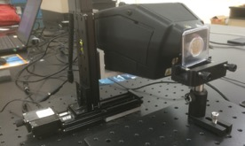
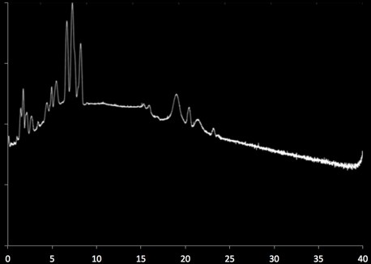
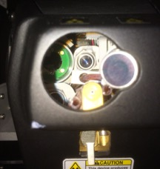
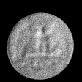

X-Ray Fluorescence (XRF) Imaging
Cu Kα, Kβ
Intensity (log scale)
10 cm x 10 cm scan stage
Energy (KeV)
SD Detector
Cu Ka Map
camera
Rh tube with 1mm spot

Slide 6
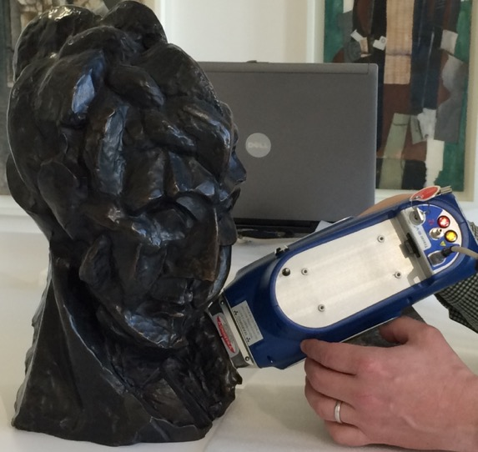
Characterizing Unique Artworks Necessitates Non-Invasive Techniques
Handled X-Ray Fluorescence Spectrometer
XRF
detector
X-Rays
Elemental Analysis
Counts number
Cu
Cr
Fe
Pb
Zn
Fluorescence energy

Slide 7
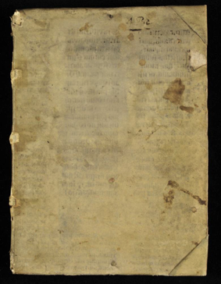
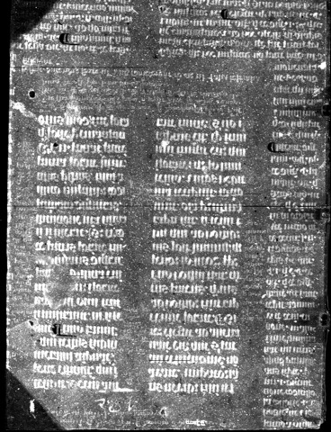
XRF maps let you see the invisible!
Fe K- line
Hesiod Manuscript (RGB Image)
XRF Map (Iron)
Beam size –Step size 200x200µm²
Dwell time 10ms/point - Att (6)

Slide 8
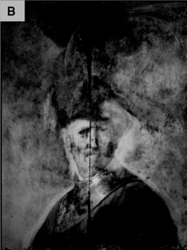
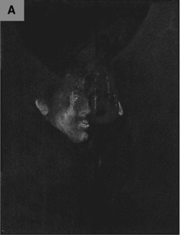
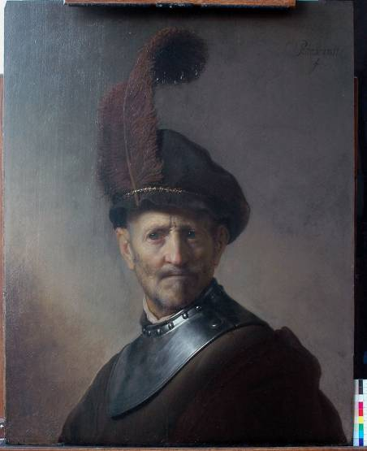
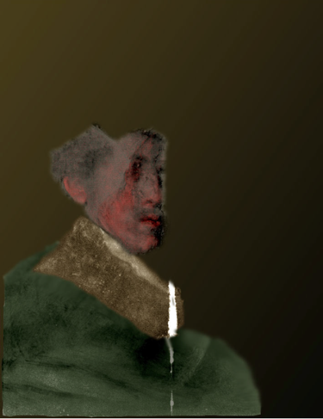
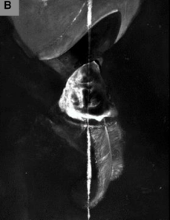
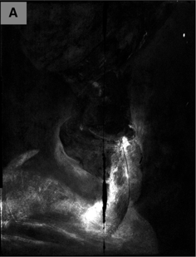
Pb Kα
Hg Kα
XRF Re-colorization of Hidden Layers
Fe Kα
Cu Kα
Rembrandt, An Old Man in Military Costume (1630), J. Paul Getty Museum, 78.PB.246
Trentelman, Karen, et al. "Rembrandt’s An Old Man in Military Costume: the underlying image re-examined." Applied Physics A 121.3 (2015): 801-811.

Slide 9
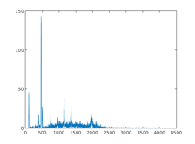

XRF Scanner Advantages & Disadvantages
Advantages
  Deep X-Ray penetration into hidden layers
  Elemental composition for chemical characterization and provenance analysis
  High spectral resolution (4096 channels)
Disadvantages
  Low Signal-to-Noise-Ratio (SNR)
  Slow raster scan process -> Low spatial resolution
  A typical XRF scan takes 2sec/pixel -> 20,000 s (6hr) for a 100x100 XRF map)

Slide 10
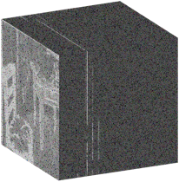
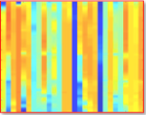







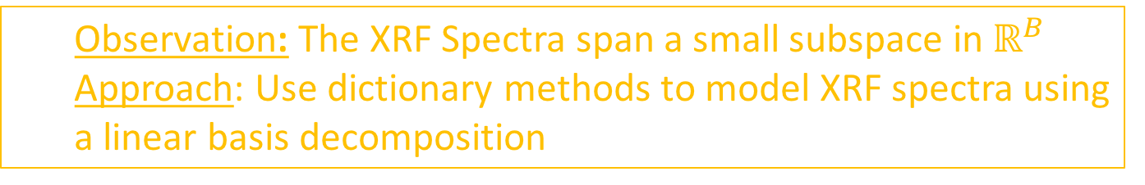
How can we make scanning Faster?
Captured XRF Datacube
Elemental XRF Dictionary
Carbon
Lead
…
Mercury
Iron
$$h$$
$$X∈ℝ^{h⋅w×B}$$
$$D^{xrf}∈ℝ^{B×N}$$
$$B$$
$$w$$
$$B$$
$$N$$
  Observation: The XRF Spectra span a small subspace in $ℝ^{B}$
  Approach: Use dictionary methods to model XRF spectra using a linear basis decomposition

Slide 11



How can we make XRF scanning faster?
Denoising -> Shorter exposure times for each pixel
Express each pixel spectra in a dictionary basis
$$\min_{D^{xrf}, A}{{\left\|X−D^{xrf}A\right\|}_{F}^{2}}$$
Super-resolution -> Faster raster scanning
Enforce a spatial prior to increase resolution
Spatial
Prior
$$\min_{D^{xrf}, A}{{\left\|X−D^{xrf}A\right\|}_{F}^{2}+P(A)}$$
RGB Image Fusion -> Faster raster scanning
Incorporate HR RGB image and coupled RGB-XRF spectral dictionary
RGB
Image
RGB
Dictionary
$$\min_{D^{rgb},{ D}^{xrf}, A}{{\left\|X−D_{}^{xrf}AS\right\|}_{F}^{2}+{\left\|I−D^{rgb}A\right\|}_{F}^{2}}$$

Slide 12
Vincent Van Gogh, The Bedroom (1889)
Art Institute of Chicago 1926.417

Slide 13
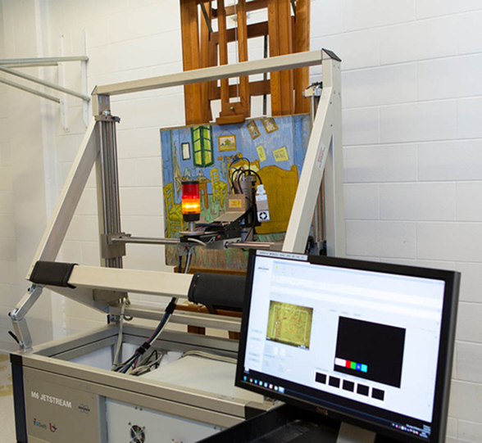
XRF Scanning of Van Gogh’s Bedroom
Notes:
Vincent van Gogh
Dutch, 1853-1890
Eosin Y is an early synthetic dye that was utilized among nineteenth century artists. The potassium or sodium salt of 2,4,5,7-tetrabromofluorescein was first made in 1871 and used for making inks. As a lake pigment, it makes a brilliant bluish red and was sold under the name of geranium lake. Van Gogh used the dye quite extensively, but unfortunately it has almost invariably faded in many of his paintings
13

Slide 14
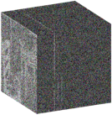
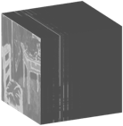




Denoising using XRF Dictionaries
Input
Output
Captured XRF Cube
XRF Dictionary
Denoised XRF Cube
$$X∈ℝ^{h⋅w×B}$$
$$D^{xrf}∈ℝ^{B×N}$$
$$Y∈ℝ^{h⋅w×B}$$
$$h$$
$$B$$
$$h$$
$$w$$
$$B$$
$$N$$
$$w$$
$$B$$
Denoising:
$${D^{xrf^{∗}},A}^{∗}=\min_{D^{xrf}, A}{{\left\|X−D^{xrf}A\right\|}_{F}^{2}}$$
$$Y_{denoise}=D^{xrf^{∗}}A^{∗}$$

Slide 15
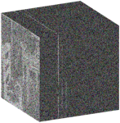


Denoising results
Denoised XRF Cube
$$Y$$
$$h$$
$$w$$
$$B$$
Captured (Noisy) XRF Cube
$$X$$
$$h$$
$$w$$
$$B$$

Slide 16
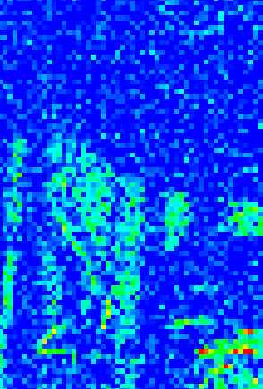


Denoising results
38cm
Captured XRF Cube
$$X$$
Denoised XRF Cube
$$Y$$
38cm
Area scanned using MA-XRF
38x38cm²
Step size: 0.400 cm
95x95Pixels
(Cobalt, Channel 857)
95x95Pixels
(Cobalt, Channel 857)
Cobalt distribution - from Cobalt Blue pigment CoAl₂O₃

Slide 17






Superresolution using XRF Dictionaries
Input
Output
Captured XRF Cube
XRF Dictionary
High Res XRF Cube
$$X∈ℝ^{h⋅w×B}$$
$$D^{xrf}∈ℝ^{B×N}$$
$$Y∈ℝ^{H⋅W×B}$$
$$B$$
$$H$$
$$h$$
$$w$$
$$B$$
$$N$$
$$W$$
$$B$$
Superresolution:
$${D^{xrf^{∗}},A}^{∗}=\min_{D^{xrf}, A}{{\left\|X−D^{xrf}A\right\|}_{F}^{2}+P(A)}$$
Spatial
Prior
Superresolution
CNN
$$Y_{denoise}=D^{xrf^{∗}}{⋅SCNN(A}^{∗})$$

Slide 18

Superresolution using XRF Dictionaries
Regularized Dictionary Learning:
Spatial smoothness
for neighbor pixels
Denoising
Objective
Positivity
Constraints
Spatial Superresolution:
[Dong et al., ECCV 2014]
$$α^{HR}=SCNN(α)$$
XRF Cube Reconstruction:

Slide 19
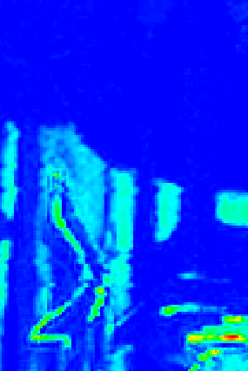
Superresolution Results
38cm
Captured XRF Cube
$$X$$
Denoised XRF Cube
$$Y$$
38cm
Area scanned using MA-XRF
38x38cm²
Step size: 0.400 cm
95x95Pixels
190x190Pixels
Cobalt distribution - from Cobalt Blue pigment CoAl₂O₃
Using Region of Interest over XRF Spectrum

Slide 20
Superresolution Results
Baseline #1: Super resolve each channel of the captured XRF cube independently using SCNN
Baseline #2: Denoise captured XRF cube then Super resolve each channel of the captured XRF cube independently using SCNN
  Our superresolution technique gives the best visual quality and fastest computation time for the Bedroom dataset

Slide 21
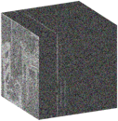
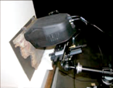
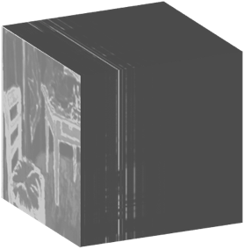
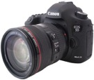
XRF Super-Resolution + RGB Image Fusion
Captured XRF Cube
XRF Scanner
$$h$$
Super-resolution
HR XRF image
$$w$$
$$B$$
Super-resolution + Fusion algorithm
Conventional
RGB image
Conventional Camera
Vincent Van Gogh, The Bedroom (1889)
Art Institute of Chicago 1926.417

Slide 22
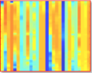















RGB Fusion using XRF Dictionaries
Input
Output
XRF Cube
HR RGB Image
RGB Dictionary
XRF Dictionary
High Res XRF Cube
$$X∈ℝ^{h⋅w×B}$$
$$I∈ℝ^{H⋅W×3}$$
$$D^{RGB}∈ℝ^{3×N}$$
$$D^{xrf}∈ℝ^{B×N}$$
$$Y∈ℝ^{W⋅H×B}$$
$$3$$
$$B$$
$$h$$
$$N$$
$$H$$
$$H$$
$$w$$
$$B$$
$$N$$
$$W$$
$$B$$
$$W$$
Superresolution + Fusion:
$$D^{rgb^{∗}},{D^{xrf^{∗}},A}^{∗}=\min_{{D^{rgb},D}^{xrf}, A}{{\left\|I−D^{rgb}A\right\|}_{F}^{2}+{\left\|X−D^{xrf}AS\right\|}_{F}^{2}}$$
$$Y_{denoise}=D^{xrf^{∗}}A^{∗}$$
Coupled Sparse Coefficients
Downsamping
Matrix

Slide 23
Fusion Results
38cm
Captured XRF Cube
$$X$$
Fused XRF Cube
$$Y$$
38cm
Area scanned using MA-XRF
38x38cm²
Step size: 0.400 cm
95x95 Pixels
475x475 Pixels
CrK Peak, Bands 611-657

Slide 24

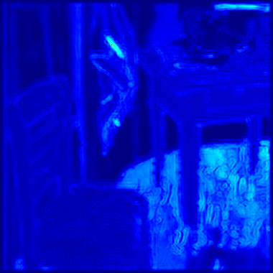
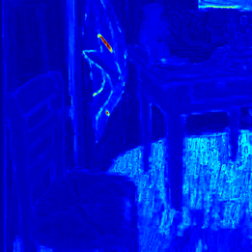

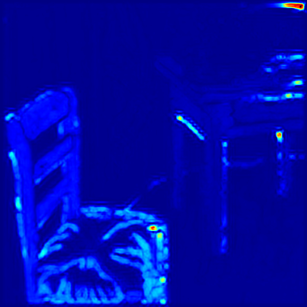
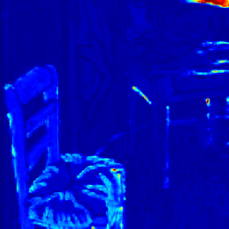
Input (95x95 pix)
Superresolution (475x475 pix)
RGB Fusion (475x475pix)
Mercury (Bands 1078-1105)
Arsenic (Bands 1243-1290)

Slide 25
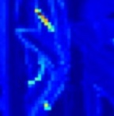
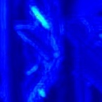
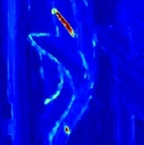
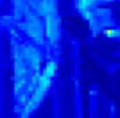
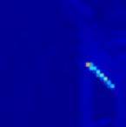
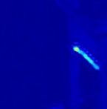
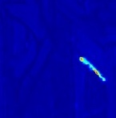
Input (95x95 pix)
Superresolution (475x475 pix)
RGB Fusion (475x475pix)
Mercury (Bands 1078-1105)
Arsenic (Bands 1243-1290)

Slide 26

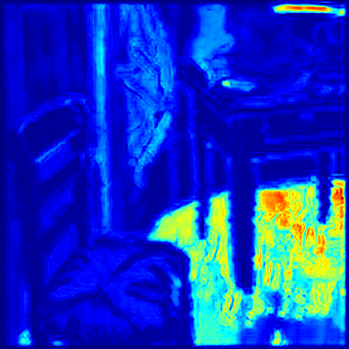
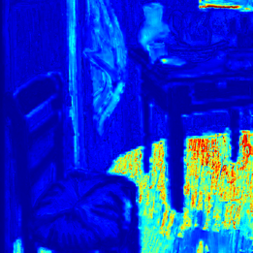

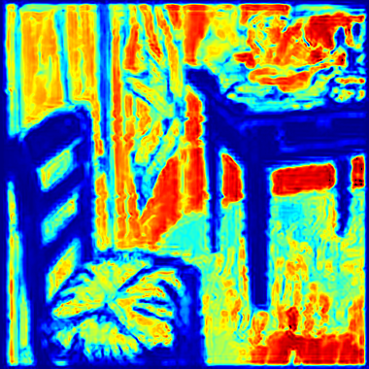
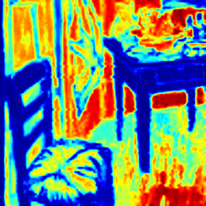
Input (95x95 pix)
Superresolution (475x475 pix)
RGB Fusion (475x475pix)
Cobalt (Bands 840-875)
Copper (Bands 875-892)

Slide 27
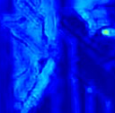
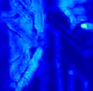



Input (95x95 pix)
Superresolution (475x475 pix)
RGB Fusion (475x475pix)
Cobalt (Bands 840-875)
Copper (Bands 875-892)

Slide 28














What about hidden layers?
Visible
Not Visible
XRF Cube
HR RGB Image
XRF Cube
$$X_{v}∈ℝ^{h⋅w×B}$$
$$I∈ℝ^{H⋅W×3}$$
$$X_{nv}∈ℝ^{h⋅w×B}$$
Input
$$h$$
$$H$$
$$h$$
High Res XRF Cube
$$w$$
$$B$$
$$w$$
$$B$$
$$Y∈ℝ^{W⋅H×B}$$
$$W$$
$$+$$
$$=$$
$$H$$
High Res XRF Cube
High Res XRF Cube
$$Y_{v}∈ℝ^{W⋅H×B}$$
$$Y_{v}∈ℝ^{W⋅H×B}$$
$$W$$
$$B$$
Output
$$H$$
$$H$$
$$W$$
$$B$$
$$W$$
$$B$$

Slide 29







RGB Fusion Model for Hidden Layers
Inputs
Outputs
$X$: Low resolution input XRF image
$X_{v}$: Visible part of $X$
$X_{nv}$: Non-visible part of $X$
$I:$ Input high resolution RGB image
$S$: Spatial down-sample matrix
$D_{v}^{xrf}$: XRF dictionary (visible)
$D_{nv}^{xrf}$: XRF dictionary (non-visible)
$D^{rgb}$: RGB dictionary
$A_{v}$: Coefficient of visible component
$A_{nv}$: Coefficient of non-visible component
Superresolution + Fusion + V/NV:
$$\min_{D^{rgb},D_{v}^{xrf},D_{nv}^{xrf},A_{v}, A_{nv}}{ }$$
$$D^{rgb^{∗}},D_{nv}^{xrf^{∗}},D_{v}^{xrf^{∗}},A_{v}^{∗},A_{nv}^{∗}=$$
Non-Visible
Total Variation
Superresolution
Non- Visible
$${\left\|X_{nv}−D_{nv}^{xrf}A_{nv}S\right\|}_{F}^{2}+{\left\|∇(D_{nv}^{xrf}A_{nv})\right\|}_{F}^{2}$$
Visible
$${\left\|I−D^{rgb}A_{v}\right\|}_{F}^{2}+{\left\|X_{v}−D_{v}^{xrf}A_{v}S\right\|}_{F}^{2}$$
Reconstruction:
$$Y=D_{nv}^{xrf^{∗}}A_{nv}^{∗}+D_{v}^{xrf^{∗}}A_{v}^{∗}$$
Visible
Coupled Coefficients

Slide 30
Hidden Layer Optimization Algorithm

Slide 31
Hidden Layer Example
XRF Cube
XRF Spectra
Layer 2
(hidden)
RGB Image
Layer 1

Slide 32
Hidden Layer Example
LR Input
No Hidden Layer Model
Proposed Method
HR Ground Truth

Slide 33


Conclusions and Future Work
XRF mapping is an emerging method for cultural heritage research
RGB Fusion methods can reduce scan time by 4x-20x
Hidden layer modeling still under development
Need more ground truth HR XRF measurements for quantitative comparisons
Want to explore different sampling strategies

